Slide 1
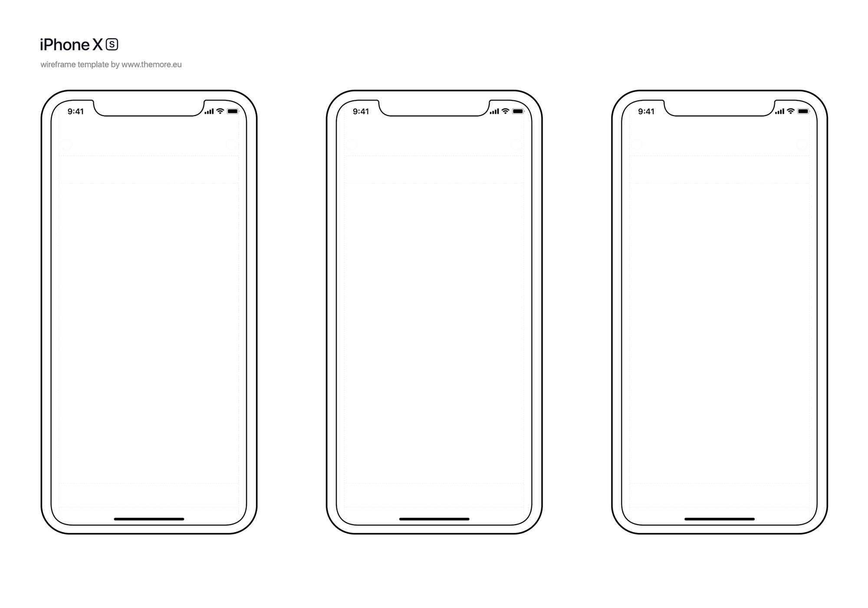

User Wireframe
Log Out
Log Out
Orders
Back
Logo/Image
Golf Course Dropdown
ATTENDANT REQUESTED!
ETA: 5 MIN
Hole Location of User
Premium Button
(Wait Time)
Username
CANCEL
Regular Button
(Wait Time)
Password
GO!
Notes:
-Do we need to have the ability to login as a golfer vs. attendant? (I.e define type of user)
-Dynamic course collection for numbers of holes and images stored in firebase that we can adjust as new courses are onboarded
-Punt on login page formatting

Slide 2
Attendant Wireframe
Log Out
Log Out
CURRENT ORDER:
ETA: XMIN
PROMISE X:XX
Logo/Image
COMPLETE
ORDER | USER | HOLE
Username
Password
GO!

